Slide 1
Welcome to Arabic Level I by Kurzban.

Slide 2
Lesson 11: الحادي عشر الدرس
Objectives:
Review
Arabic Alphabet: Two-Way Connectors
Arab States: Identifying and inquiring about Arab countries, capitals, and cities (lesson 12 + letters وغ ع
Practice
Summary
Work on greetings

Slide 3
Greetings
How do you say: Hello, my name is, where are you from ? And you are?
Do you recognize these letters? White board activity

Slide 4

Lesson 11: Review
Copy down and translate the following words on your paper several times and remember to proceed from right to left.
مِن اين انتِ؟ انا من نيويورك
اين نيويورك؟ نيويورك في الوِلايات المُتَّحِدة

Slide 5
Lesson 11: Arabic Alphabet
ص ض ط ظ ع غ
These two letters share one basic shape. They are differentiated only by a dot placed above ض.
Examine these letters below and practice writing them.

Slide 6
Lesson 11: Working with ص and ض
______________________________ص
_____________________________ ض
They are written in one stroke moving clockwise.

Slide 7
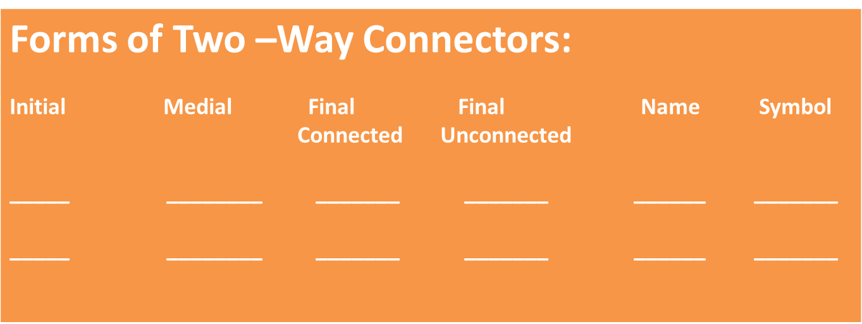
Lesson 11: Working with صاد and ضاد

Slide 8
Lesson 11: Mini Practice 1
Listen to the following words as you read them and repeat during practice. Then copy them several times on a ruled sheet of paper
نَصير
بَيْض
ضَرير
فُرصة
صَبور

Slide 9
Lesson 11: Arabic Alphabet
ط ظ
The letters Ta (where t should have a dot underneath) ط and za (where z should have a dash underneath) ظ and their sound:
These two letters share one basic shape. They are differentiated only by a dot placed above The loop is ظ .
Examine these letters below and practice writing them.

Slide 10
Lesson 11: Mini Practice 1
Translation
Naseer
Eggs
Patient
Opportunity
Blind

Slide 11
Lesson 11: Working with ط and ظ
_____________________________ط
_______________________________ ظ
They are written in one stroke moving clockwise and flush on the line

Slide 12
Combine the letters in each set, including short vowels, to form words
طَ+ر+ب+و+ش=
قِ+ط+ا+ر=
فَ+ظ+ا+ظ+ة=
ب+و+ص=
رُ+ط+ب=

Slide 13
Lesson 11: Working with ظ and ط

Slide 14
Lesson 11: Mini Practice 2
Listen to the following words as you read them and repeat during practice. Then copy them several times on a ruled sheet of paper
ظَريف
خَطير
خُطوط
حظيرة

Slide 15
Lesson 11: Mini Practice 2
Translation
Dangerous
Lines
Coop
nice

Slide 16
Translation
Hat
Rudeness
Wet
Boss
Train

Slide 17
Dictation
Listen to each word dictated to you and write it down on a ruled sheet of paper. Each word will be read twice.
طباشر فَيض
رتيب رصين
طريق ظريف

Slide 18

Review
Review
Make your flash card for this lesson
Questions????

Slide 19
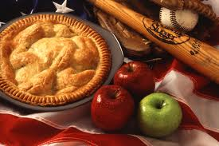
Today’s treat is presented by Nadine
فطيرة التفاح
تفاح
سكر
زبدة
فطيرة قمة

